Slide 1
Arabic AI Text Detection Using Apache Spark and Machine Learning
by Abdulaziz Alsehli

Slide 2
Project Idea
Problem:
Detecting AI-generated Arabic text has become increasingly important.
Goal:
Build a scalable Arabic text classification system using Apache Spark and machine learning.

Slide 3
Technologies Used
- Python
- Apache Spark
- Hadoop HDFS
- PySpark MLlib
- TF-IDF

Slide 4
Methodology
1. Load dataset
2. Clean Arabic text
3. TF-IDF feature extraction
4. Train ML models
5. Evaluate performance
Models:
- Logistic Regression
- Random Forest
- Linear SVM

Slide 5
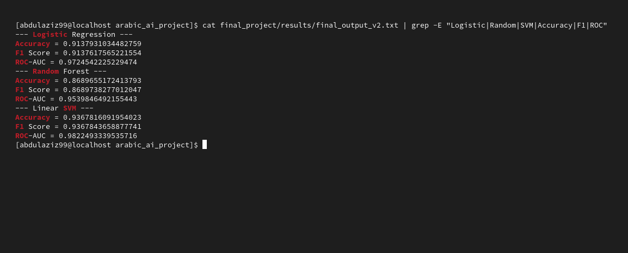
Results
| Model | Accuracy |
|---|---|
| Logistic Regression | 91.38% |
| Random Forest | 86.90% |
| Linear SVM | 93.67% |
Best Model:
Linear SVM
ROC-AUC:
98.22%

Slide 6
Streaming Pipeline
Implemented Spark Structured Streaming for real-time Arabic text processing.
Features:
- Real-time input
- Continuous processing
- Scalable architecture

Slide 7
Conclusion
- Successfully detected Arabic AI-generated text.
- Apache Spark improved scalability.
- Linear SVM achieved the best performance.
Future Work:
- Deep learning
- Transformers
- Real-time deployment

Slide 8
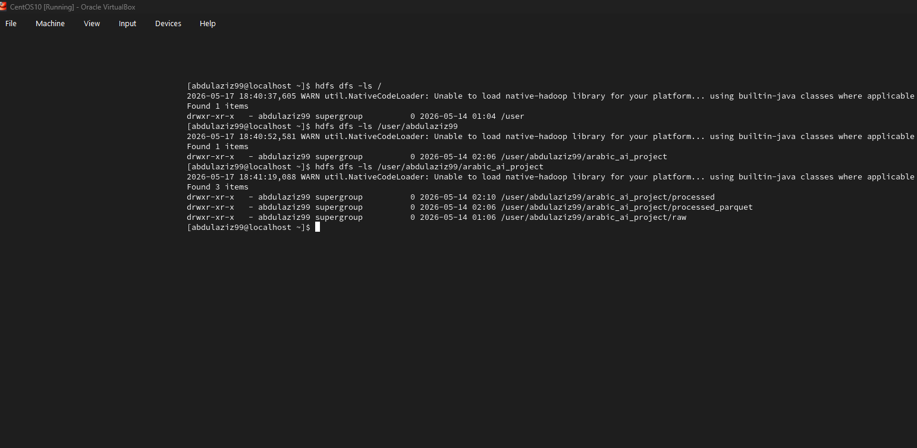
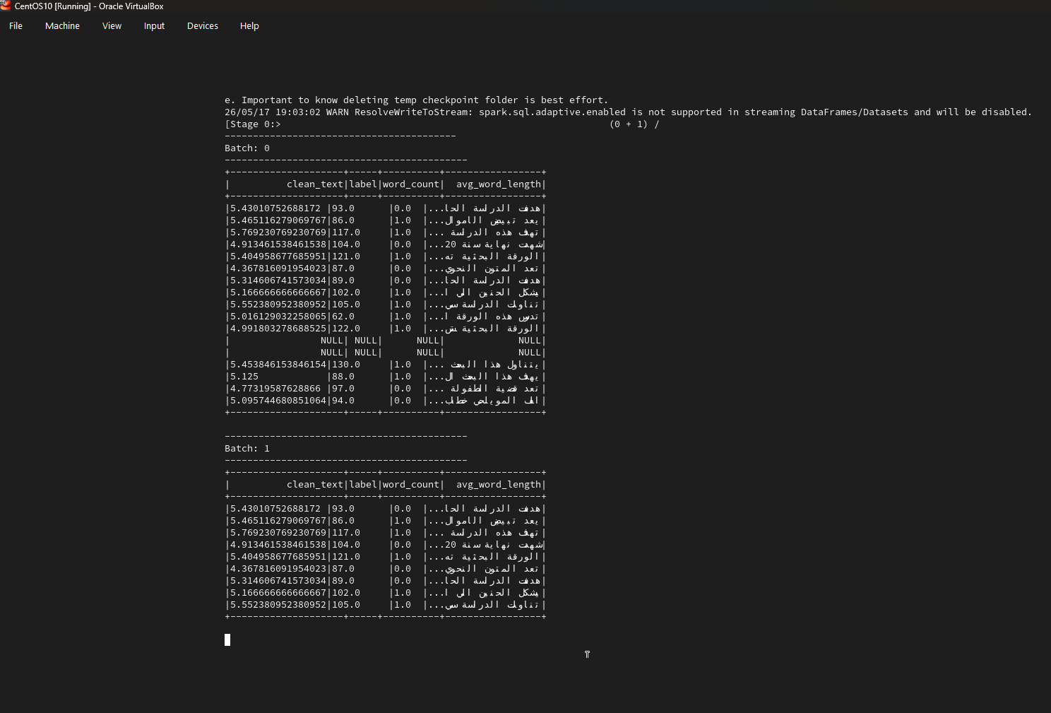
Project implementation

Slide 9
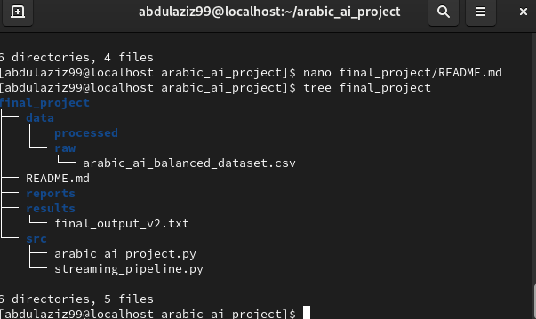
Project implementation

Slide 10
Thank You
Questions?

